Slide 1
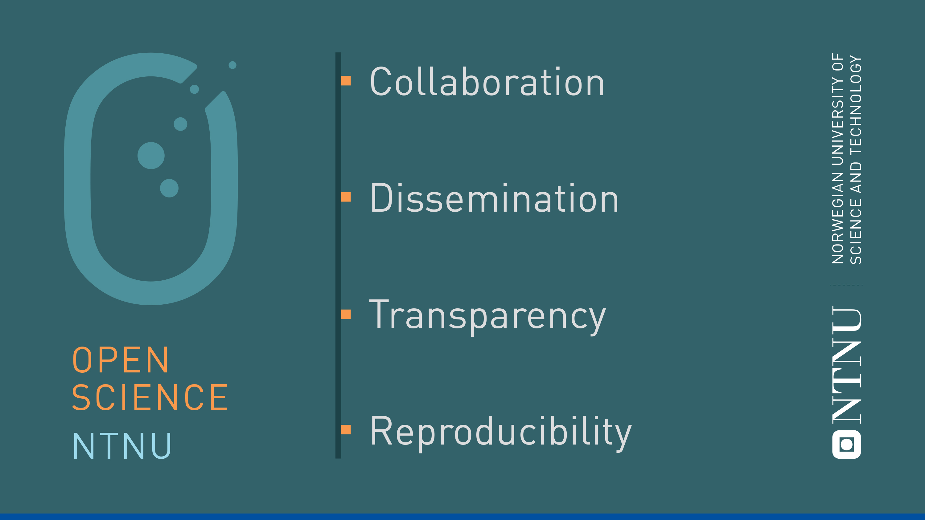
Data management at NTNU
Introduction to data management resources
Ane Møller Gabrielsen
Ingrid Heggland
NTNU University Library

Slide 2
Open and free sharing of knowledge
Reproducible, responsible and accessible research
«As open as possible, as closed as necessary»

Slide 3
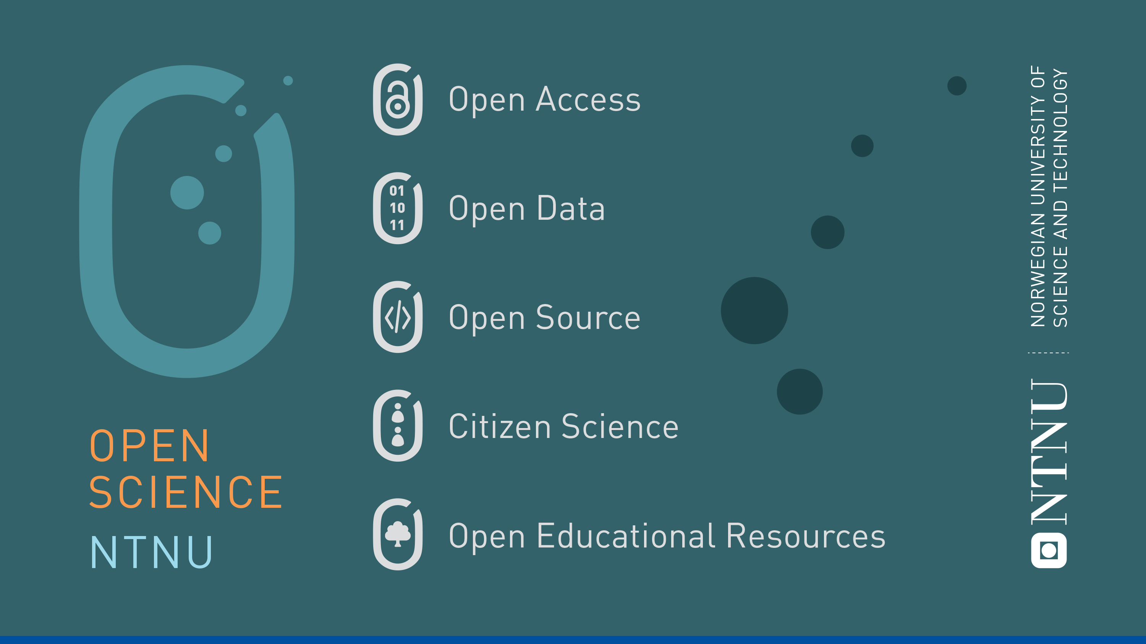

Slide 4
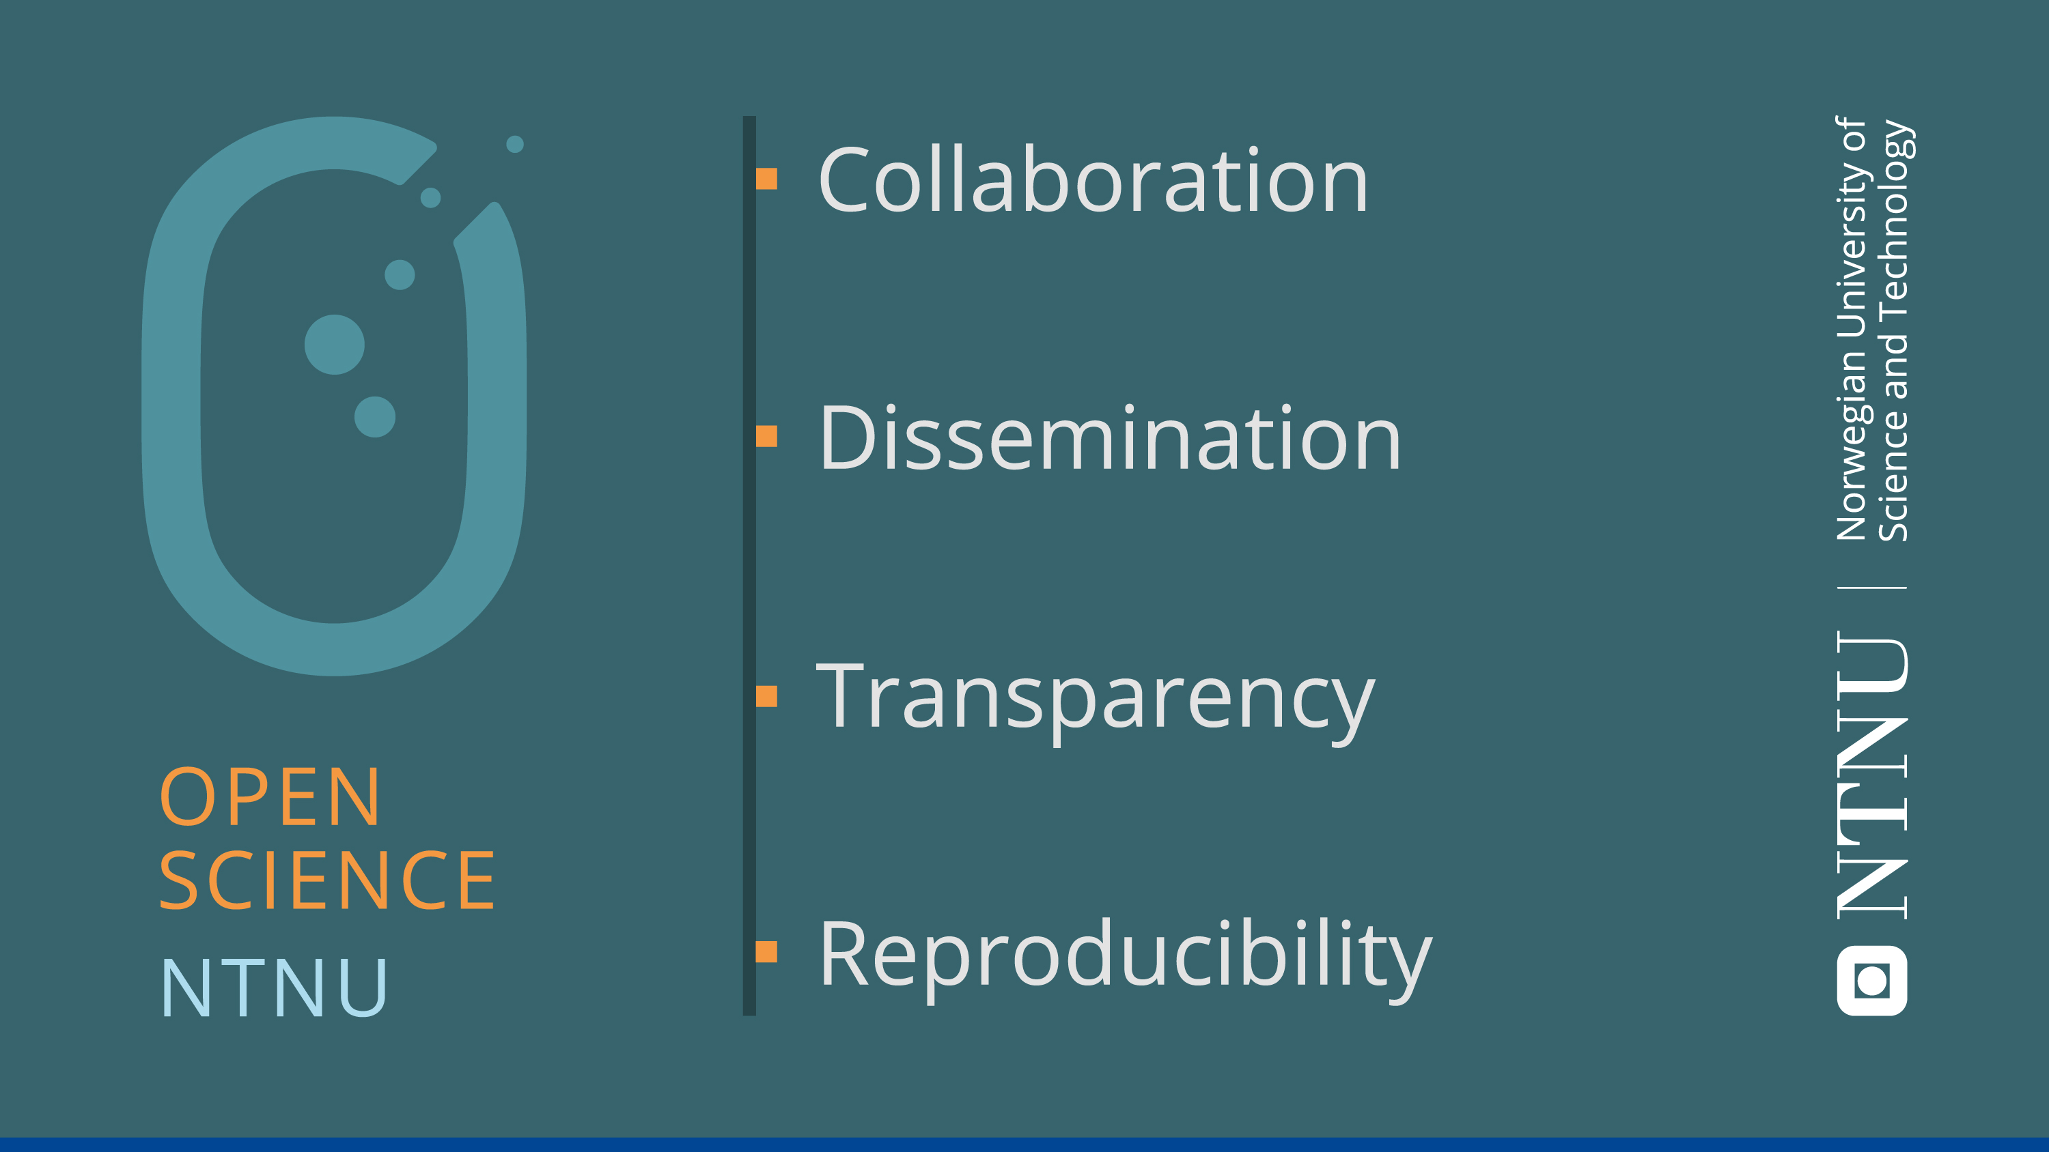

Slide 5

Open Science at NTNU
New policy for Open Science
Previously: Policy for Open Access (2014) and policy for Open Research Data (2018)
NTNU University Library point of contact and coordination for Open Science at NTNU
Support services, tools, and guidance
Collaboration with IT and departments and faculties

Slide 6

Research data at NTNU:
As open as possible, as closed as necessary
Data should be:
NTNU guarantees for access to infrastructure and support services
The researcher is responsible for the quality
All projects should have a DMP

Slide 7
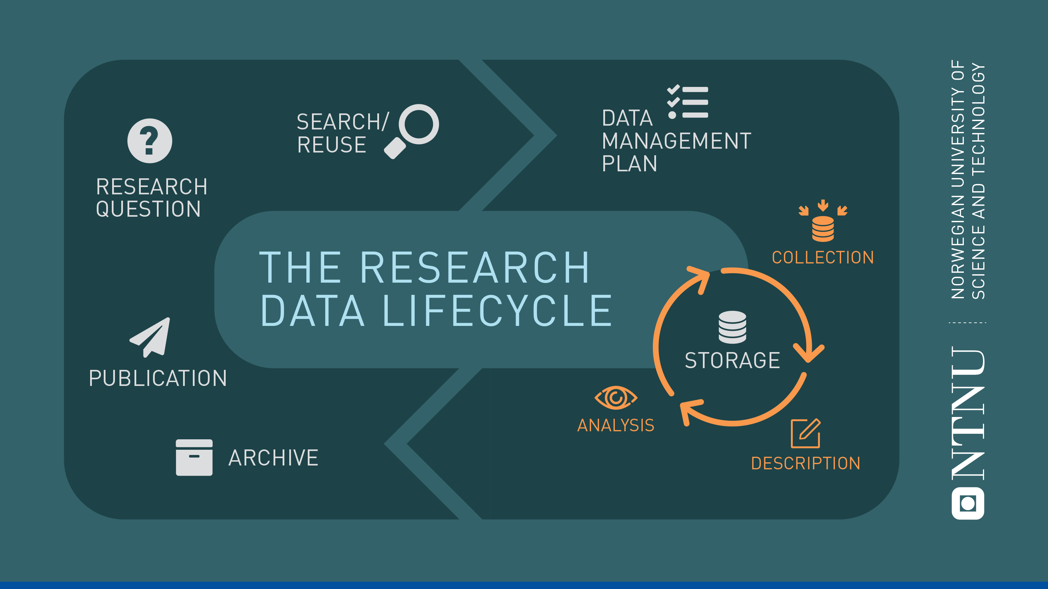
Open Science and good research data management go hand in hand!

Slide 8
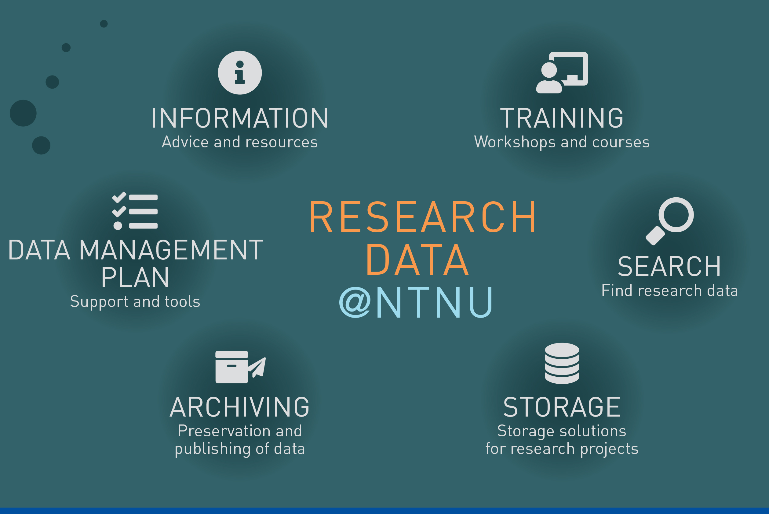
Support and guidance: Research Data @NTNU
Central support service for research data
Coordinated by the library in close collaboration with IT
Support for data management throughout the data lifecycle
innsida.ntnu.no/researchdata
research-data@ntnu.no

Slide 9
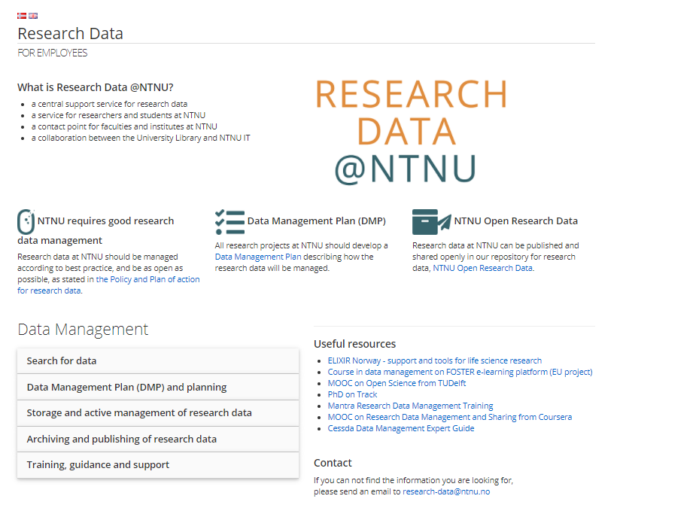

Slide 10
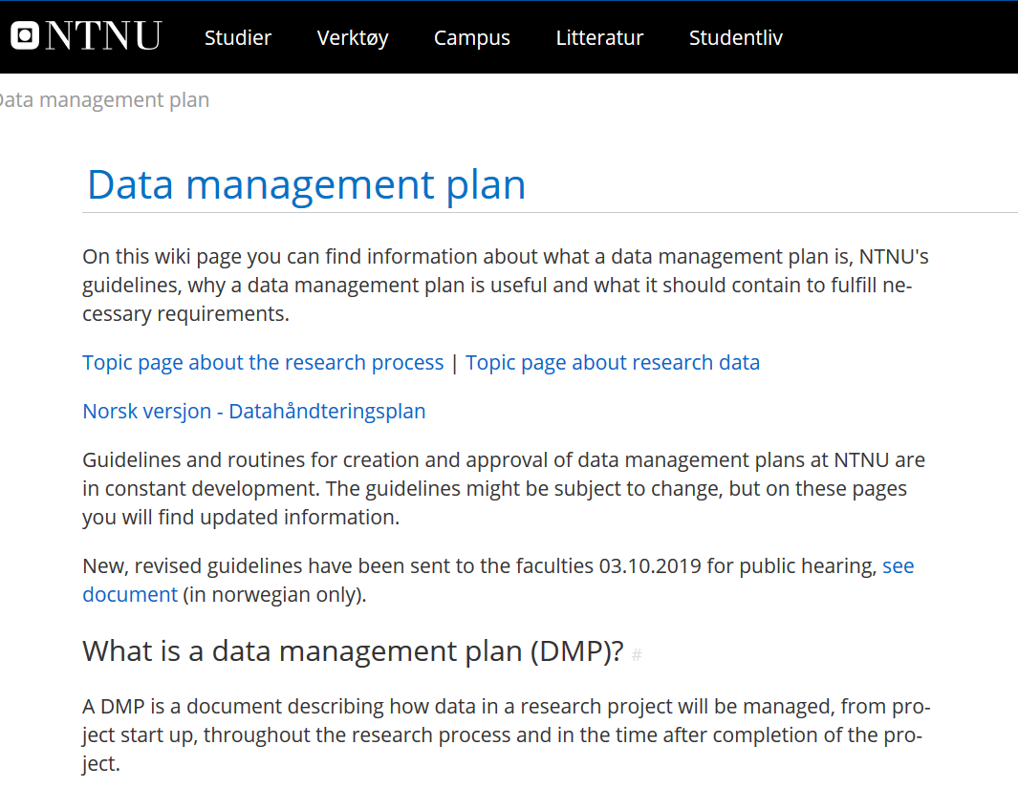
Support and guidance at Innsida
Wikis:
Data management plan (info and guidelines)
DMP guidance

Slide 11
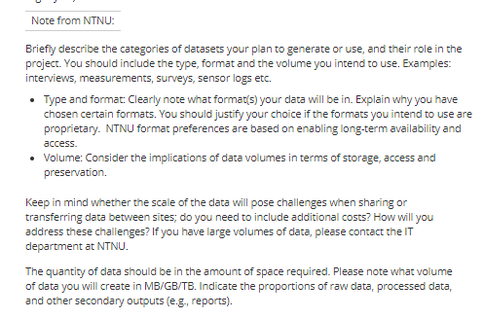
NTNU DMP Guidance

Slide 12
NTNU Storage and Computing Resources

Slide 13
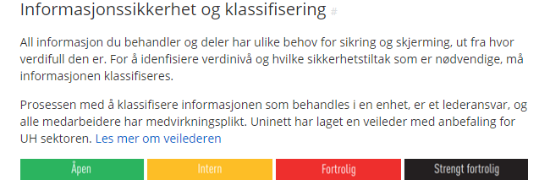
Storage: Information Security
All information (including research data) should be classified, to help choose the correct storage
Open, Internal, Confidential, Strictly confidential
https://innsida.ntnu.no/wiki/-/wiki/Norsk/Informasjonsklassifisering+-+informasjonssikkerhet

Slide 14
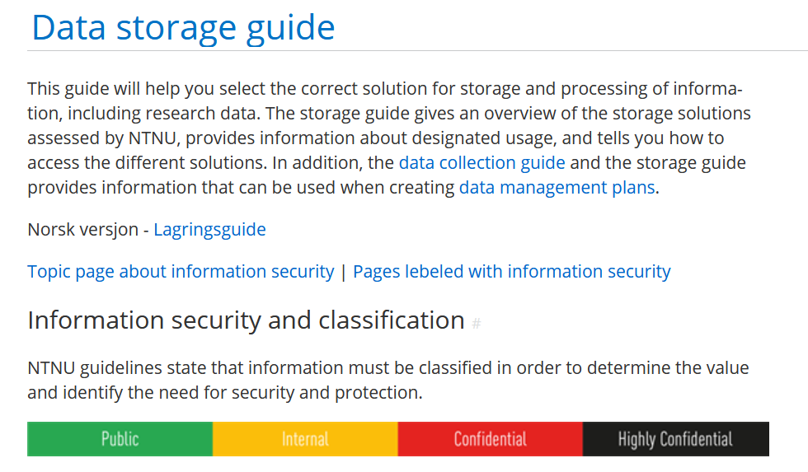
Confidentiality: How important is it that the information does not fall into the wrong hands?
Open
Internal
Confidential
Strictly confidential
Integrity: How important is it that the information is not modified by unauthorised persons or by accident?
Accessability: How critical is it to lose access to the information for a period of time, or to lose it completely? (Example: If you store your data on M:, no one can access it if you quit.)

Slide 15
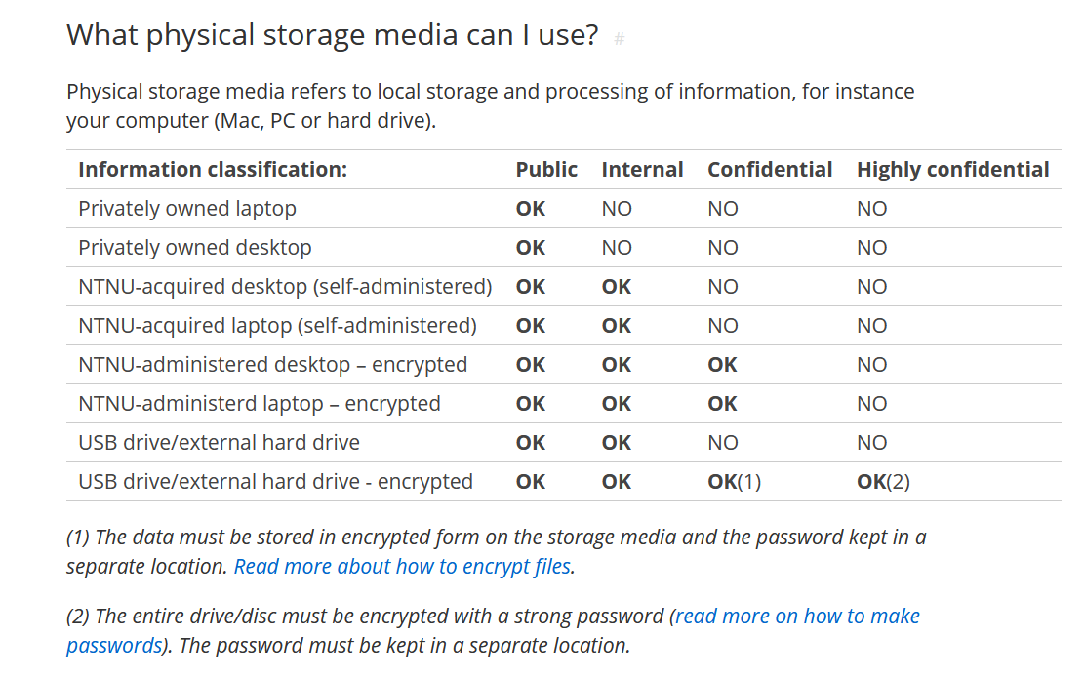
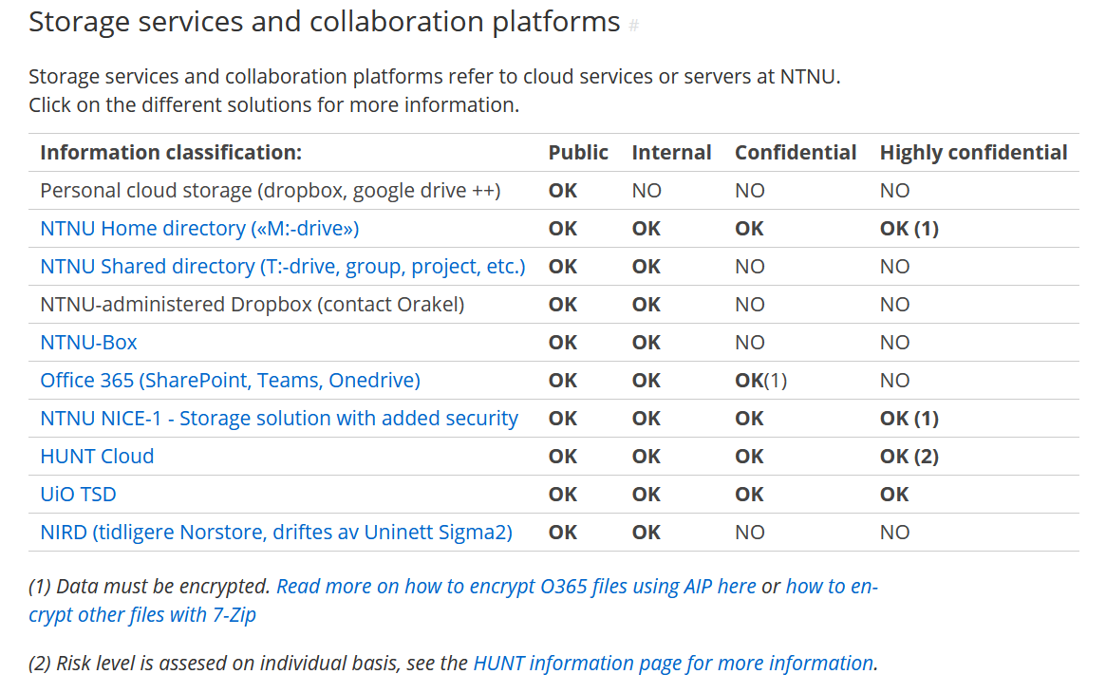
https://innsida.ntnu.no/wiki/-/wiki/English/Data+storage+guide

Slide 16




Research
Software
Engineering
Laboratory Instrumentation
and Support
RSE
LAB
NTNU IT – Research Support
IT support for PhD students
High
Performance
Computing
HPC
Mime

Slide 17
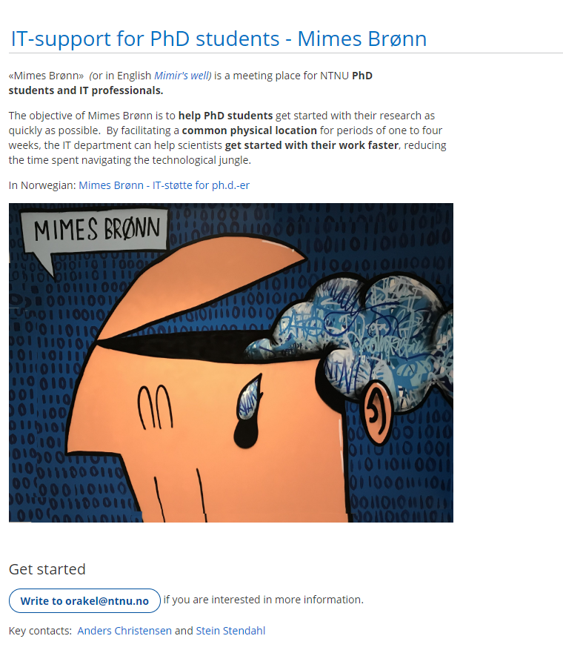
RSE
LAB
IT support for PhD students
Mime
HPC

Slide 18
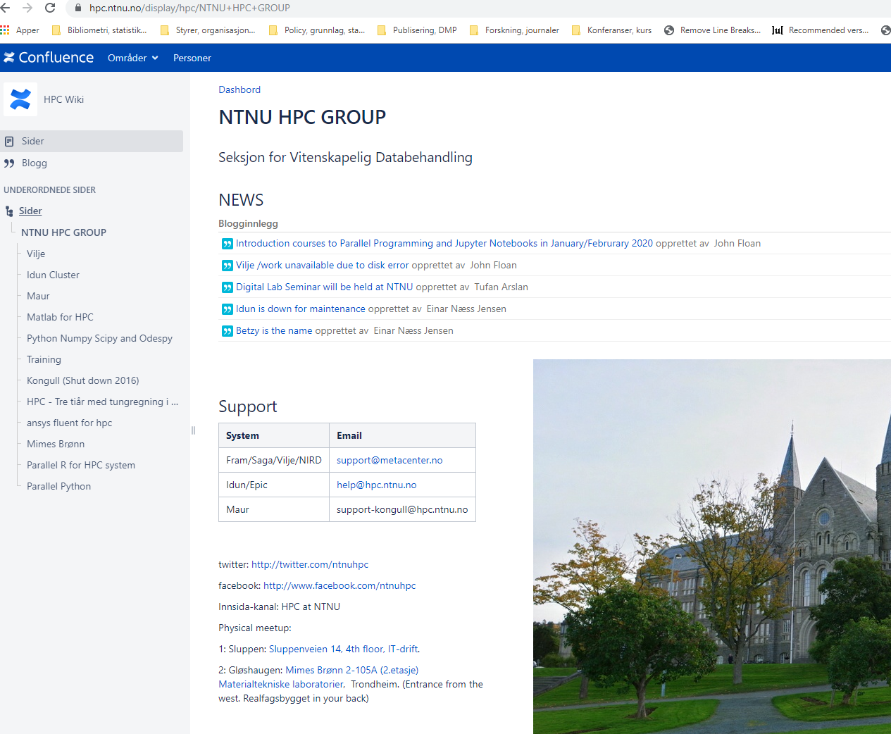
RSE
LAB
High
Performance
Computing
HPC
Mim
HPC

Slide 19
NTNU Open Research Data
DataverseNO

Slide 20
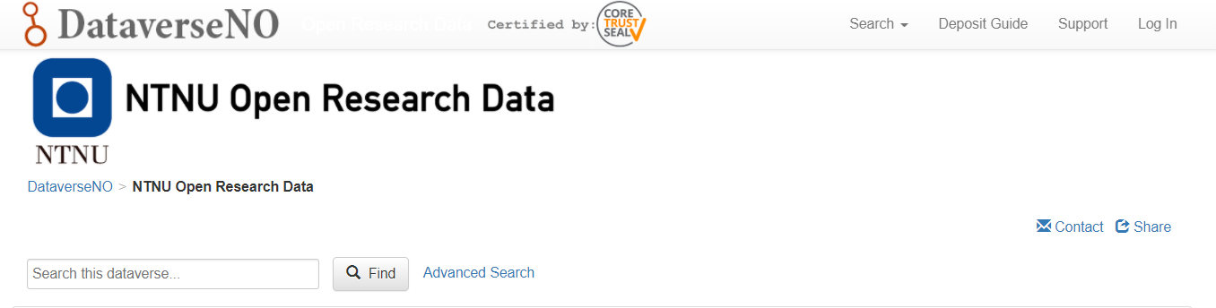
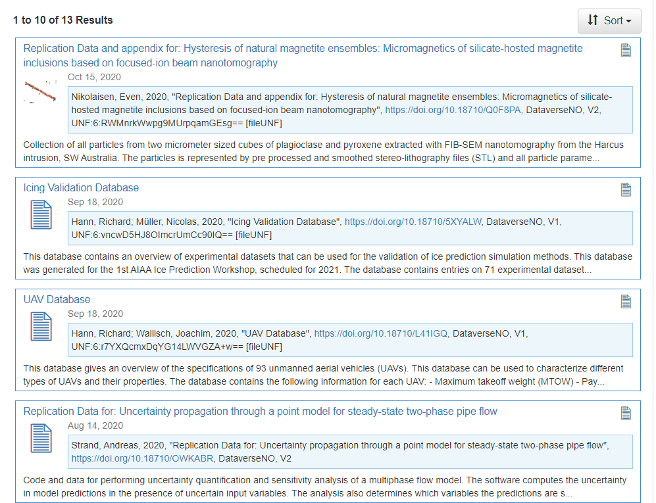

Slide 21
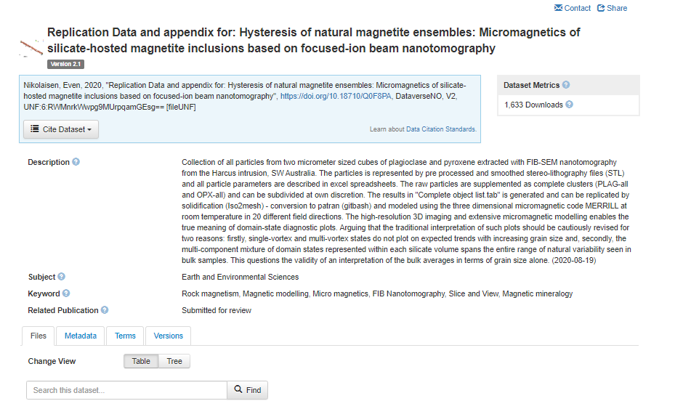
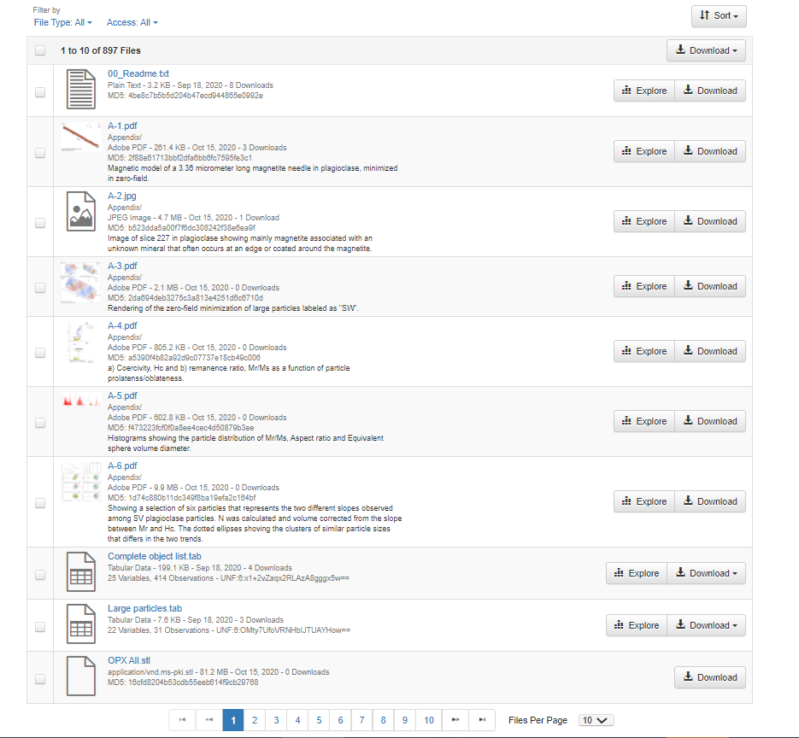
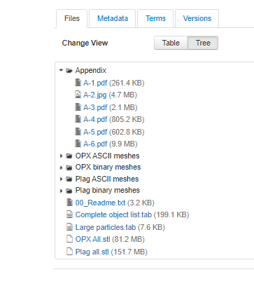

Slide 22
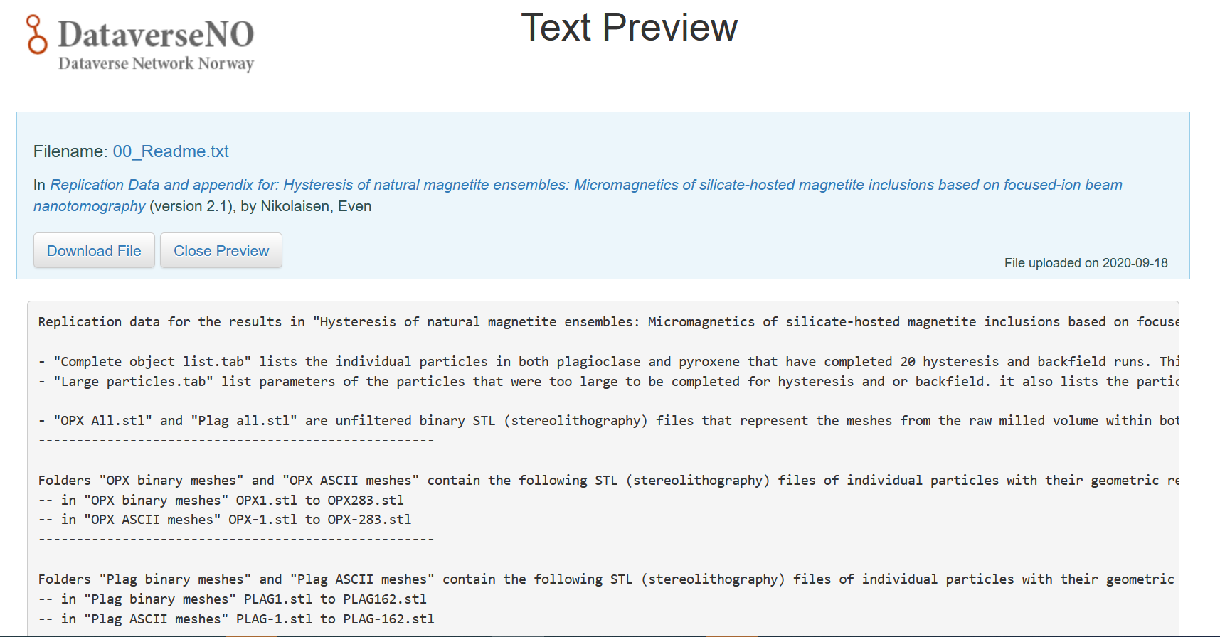

Slide 23
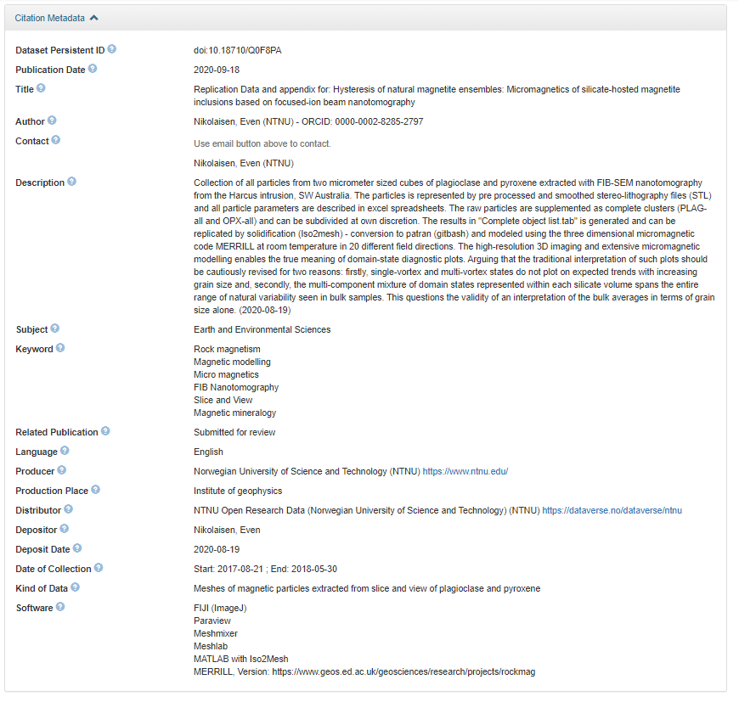
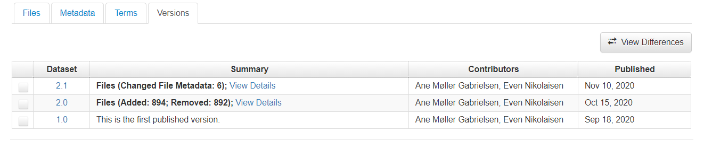
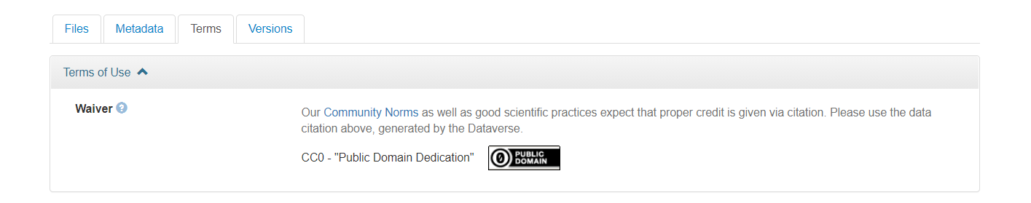

Slide 24
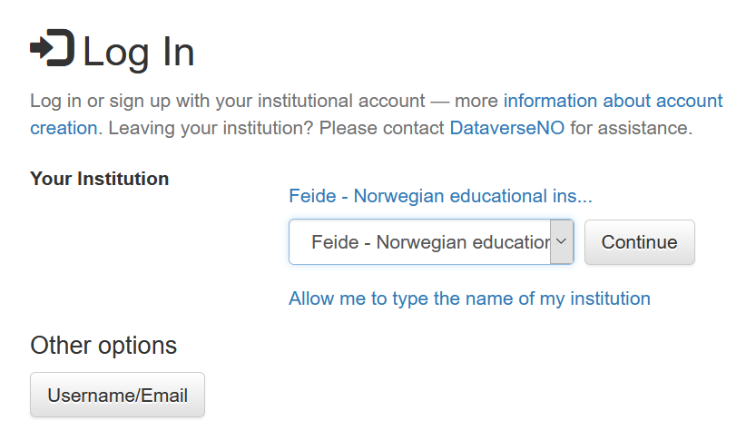
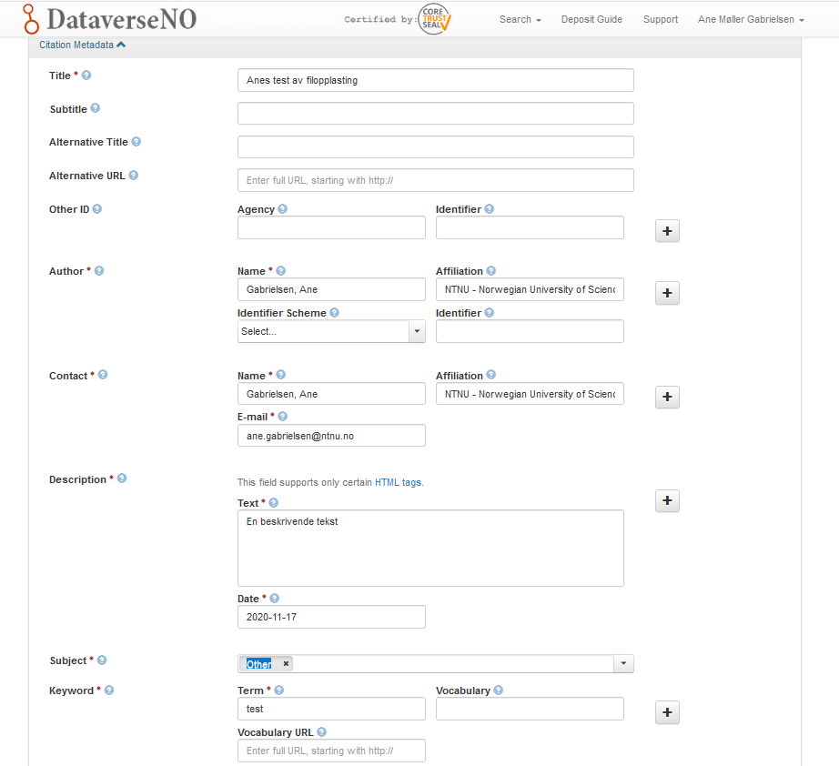

Slide 25
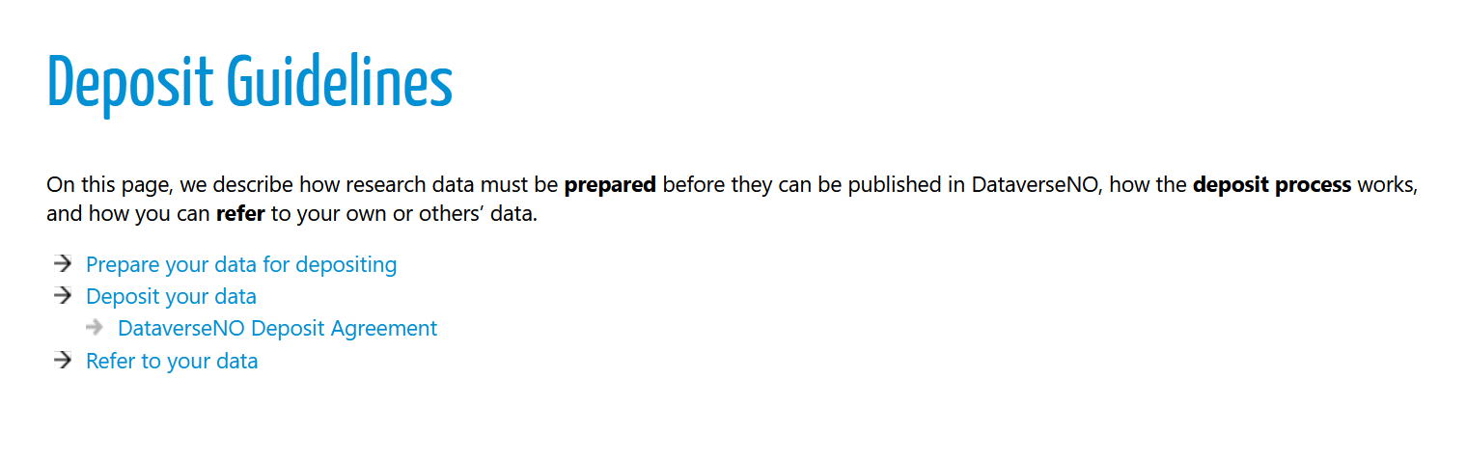
Please read ☺

